Slide 1
Paper towel usage
By Hendrix, 5-D

Slide 2
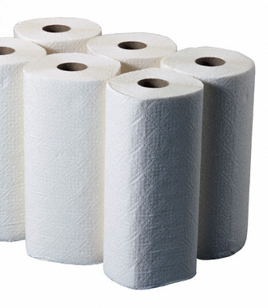
Data collected on a questionnaire on Facebook: 68 responded of 360 asked.
Questions asked: How many people live in your home? How many rolls of paper towels do you use in one week?
This Photo by Unknown author is licensed under CC BY-SA.

Slide 3
Research
They cannot be recycled
Decomposing hand towels contributes to gobal warming
They get dumped into the water causing pollution
Air hand dryers use 25% less energy than paper processing
If every house in the U.S.A used 3 less rolls per year, it would be 120,000 tons less waste

Slide 4
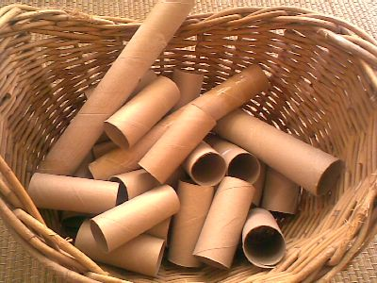
What my data shows.
68 households use 82 rolls of paper towel each week
6 rolls in a household of four people was the highest usage reported
0 rolls used in three separate households was the lowest usage reported
The average household uses 1.25 rolls of paper towels each week
This Photo by Unknown author is licensed under CC BY.

Slide 5
Let's celebrate earth day #50 by using less paper towels!
Solution-Respond to each person who answered my questionnaire with this message:
"Happy earth day 2020! Did you know that if every family in the USA used just 3 less rolls of paper towels each YEAR, it would help the U.S.A save 120,000 tons of waste, $4 million in landfill costs, and 1.5 Million trees!? Please do your part by using 3 less rolls each year. Thank you! Here are some ideas:
Use cloth towels or rags made from old tshirts, launder as needed
Use cloth napkins, launder as needed
Shake your hands dry in the sink
Save your napkins from takeout meals
Just don't buy them
Only buy select-a-size, and use half a sheet at a time."

Slide 6
Sources
Intelligenthanddryers.com
Pulpandpaper-technology.com
Cottagecare.com

